Slide 1
Item | W0 | W1 | W2 | W3 | W4 | W5 | W6 | - | W7 | W8 | W9 | W10
[Deadline] Research Proposal | 6-11
RQ 1: Finding data sets
RQ 1: Generating a framework
RQ 2: Research mathematical foundation of NGs
RQ 2: Develop Python NG generation tool
RQ 2: Test and validate the NG generation tool
RQ 3: Literature review on Markov Chains
[Deadline] Draft Paper |  |  |  |  |  | 11-12
RQ 3: Develop Python visualization tool for NGs
RQ 3: Characterize NGs
MQ: Combine RQs
MQ: Conclude MQ
Proofread
[Deadline] Final Paper |  |  |  |  |  |  |  |  |  |  | 22-01
[Deadline] Presentation |  |  |  |  |  |  |  |  |  |  |  | 29-01

Slide 2
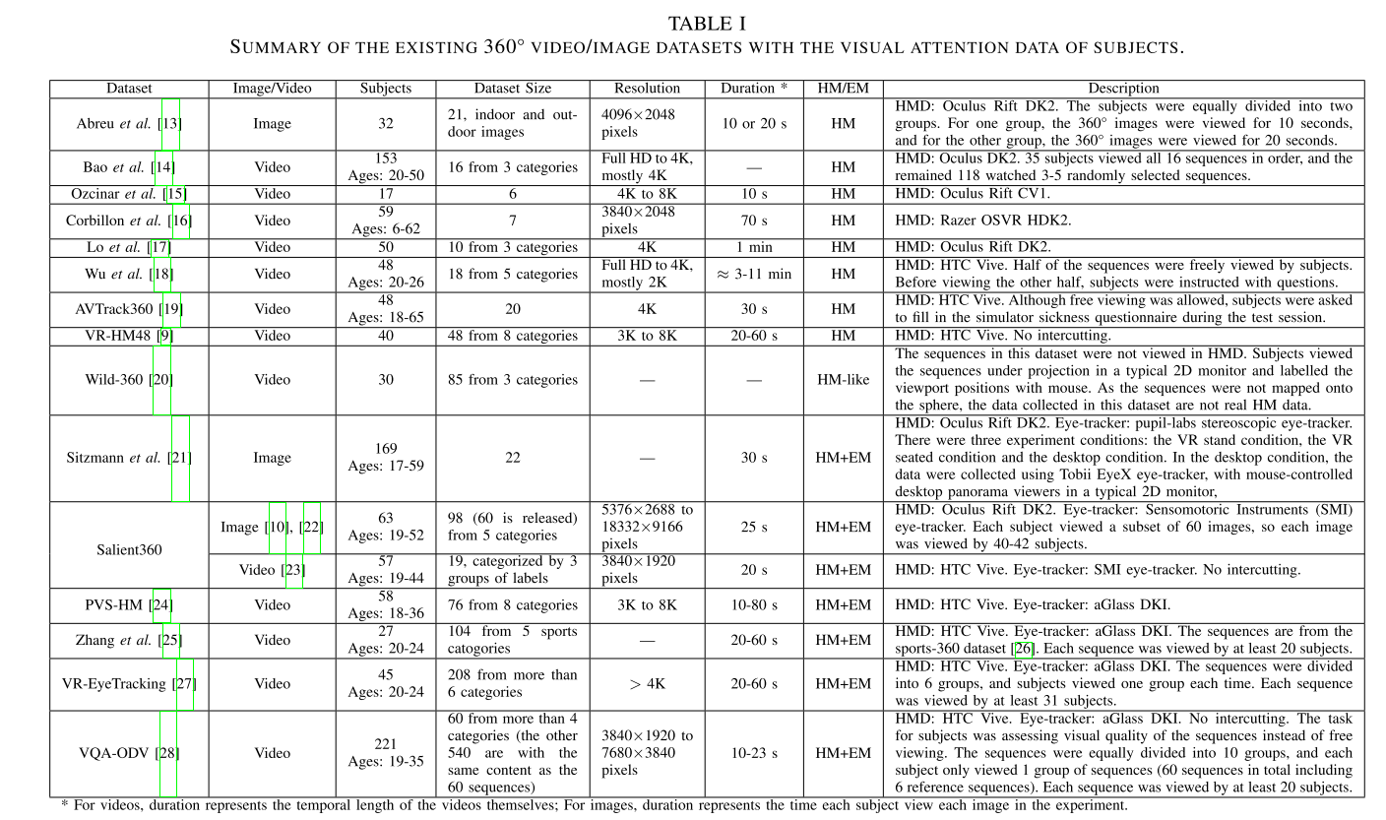

Slide 3
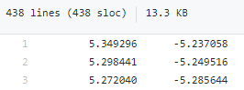
Dataset:
Paper:
40 participants
18 videos
5 categories
Unit-quaternion
X/Y/Z
https://dl-acm-org.ezproxy2.utwente.nl/do/10.1145/3192423/abs/
https://dl-acm-org.ezproxy2.utwente.nl/doi/10.1145/3083187.3083210
https://github.com/Archer-Tatsu/head-tracking
Data set:
Paper:
40 participants
48 videos
8 categories
Latitude/longitude
https://ieeexplore-ieee-org.ezproxy2.utwente.nl/abstract/document/8019351

Slide 4
Item | W0 | W1 | W2 | W3 | W4 | W5 | W6 | - | W7 | W8 | W9 | W10
[Deadline] Research Proposal | 6-11
RQ 1: Finding data sets
RQ 1: Generating a framework
RQ 2: Research mathematical foundation of NGs
RQ 2: Develop Python NG generation tool
RQ 2: Test and validate the NG generation tool
RQ 3: Literature review on Markov Chains
[Deadline] Draft Paper |  |  |  |  |  | 11-12
RQ 3: Develop Python visualization tool for NGs
RQ 3: Characterize NGs
MQ: Combine RQs
MQ: Conclude MQ
Proofread
[Deadline] Final Paper |  |  |  |  |  |  |  |  |  |  | 22-01
[Deadline] Presentation |  |  |  |  |  |  |  |  |  |  |  | 29-01

Slide 5
https://github.com/Archer-Tatsu/head-tracking
Data set:
Paper:
40 participants
48 videos
8 categories
Latitude/longitude
https://ieeexplore-ieee-org.ezproxy2.utwente.nl/abstract/document/8019351

Slide 6
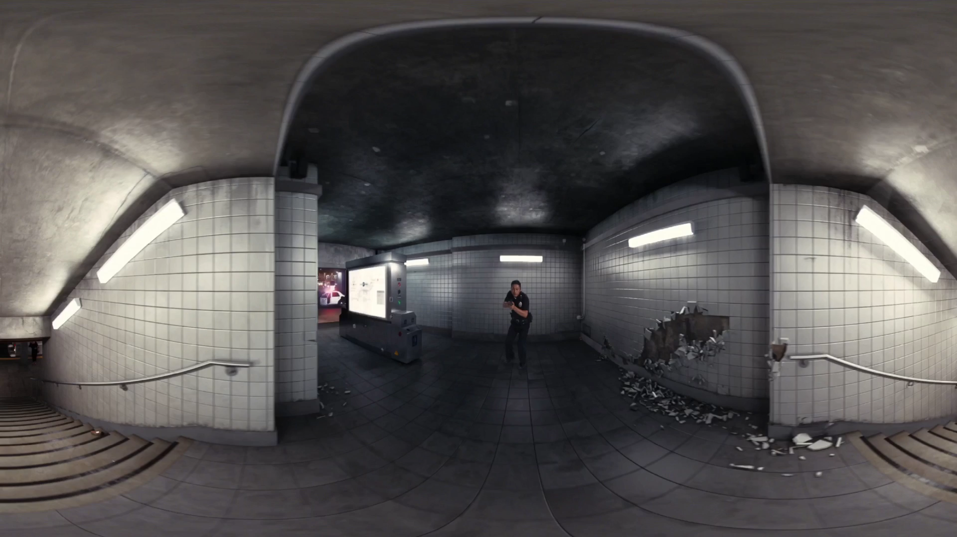

Slide 7
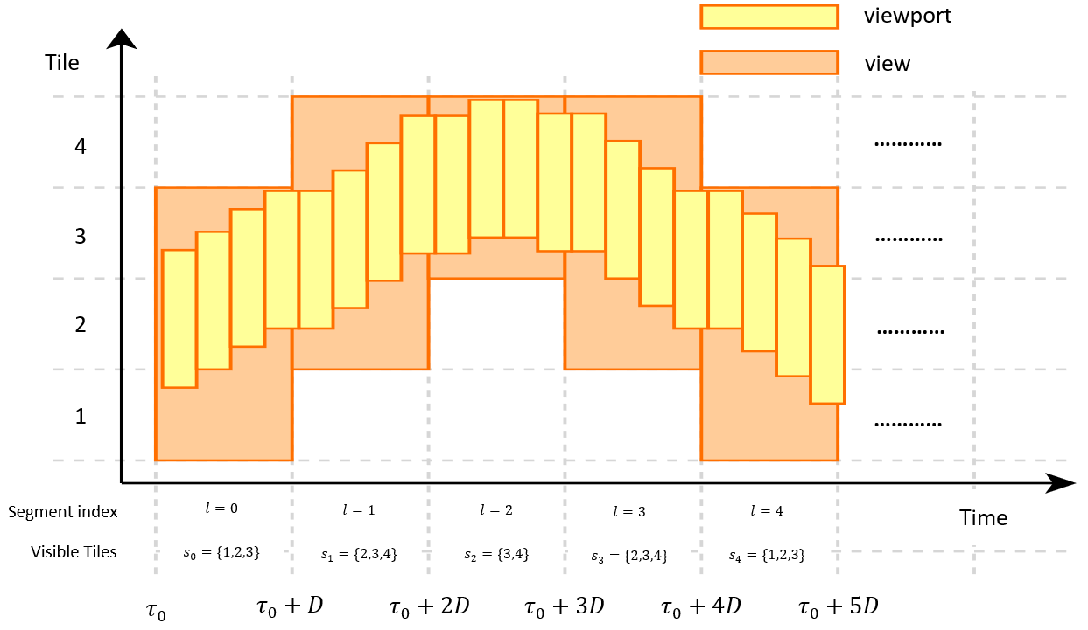
Tiling and segment length is up to us
Navigation graph is about view transitions
View: union of viewports within one segment
Nodes: {Set of Tiles, Segment index}
Edges: {Weight function (probability of from one node to the next)}

Slide 8
Item | W0 | W1 | W2 | W3 | W4 | W5 | W6 | - | W7 | W8 | W9 | W10
[Deadline] Research Proposal | 6-11
RQ 1: Finding data sets
RQ 1: Generating a framework
RQ 2: Research mathematical foundation of NGs
RQ 2: Develop Python NG generation tool
RQ 2: Test and validate the NG generation tool
RQ 3: Literature review on Markov Chains
[Deadline] Draft Paper |  |  |  |  |  | 11-12
RQ 3: Develop Python visualization tool for NGs
RQ 3: Characterize NGs
MQ: Combine RQs
MQ: Conclude MQ
Proofread
[Deadline] Final Paper |  |  |  |  |  |  |  |  |  |  | 22-01
[Deadline] Presentation |  |  |  |  |  |  |  |  |  |  |  | 29-01

Slide 9
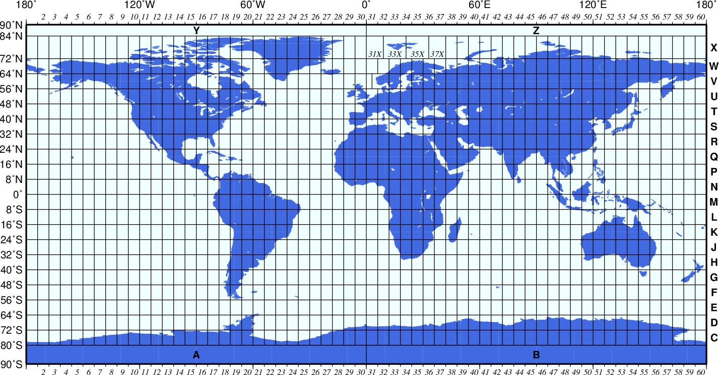
Source: Art of Directional Drilling: UTM COORDINATE SYSTEM (UNIVERSAL TRANSVERSE MERCATOR) (directionaldrillingart.blogspot.com)

Slide 10
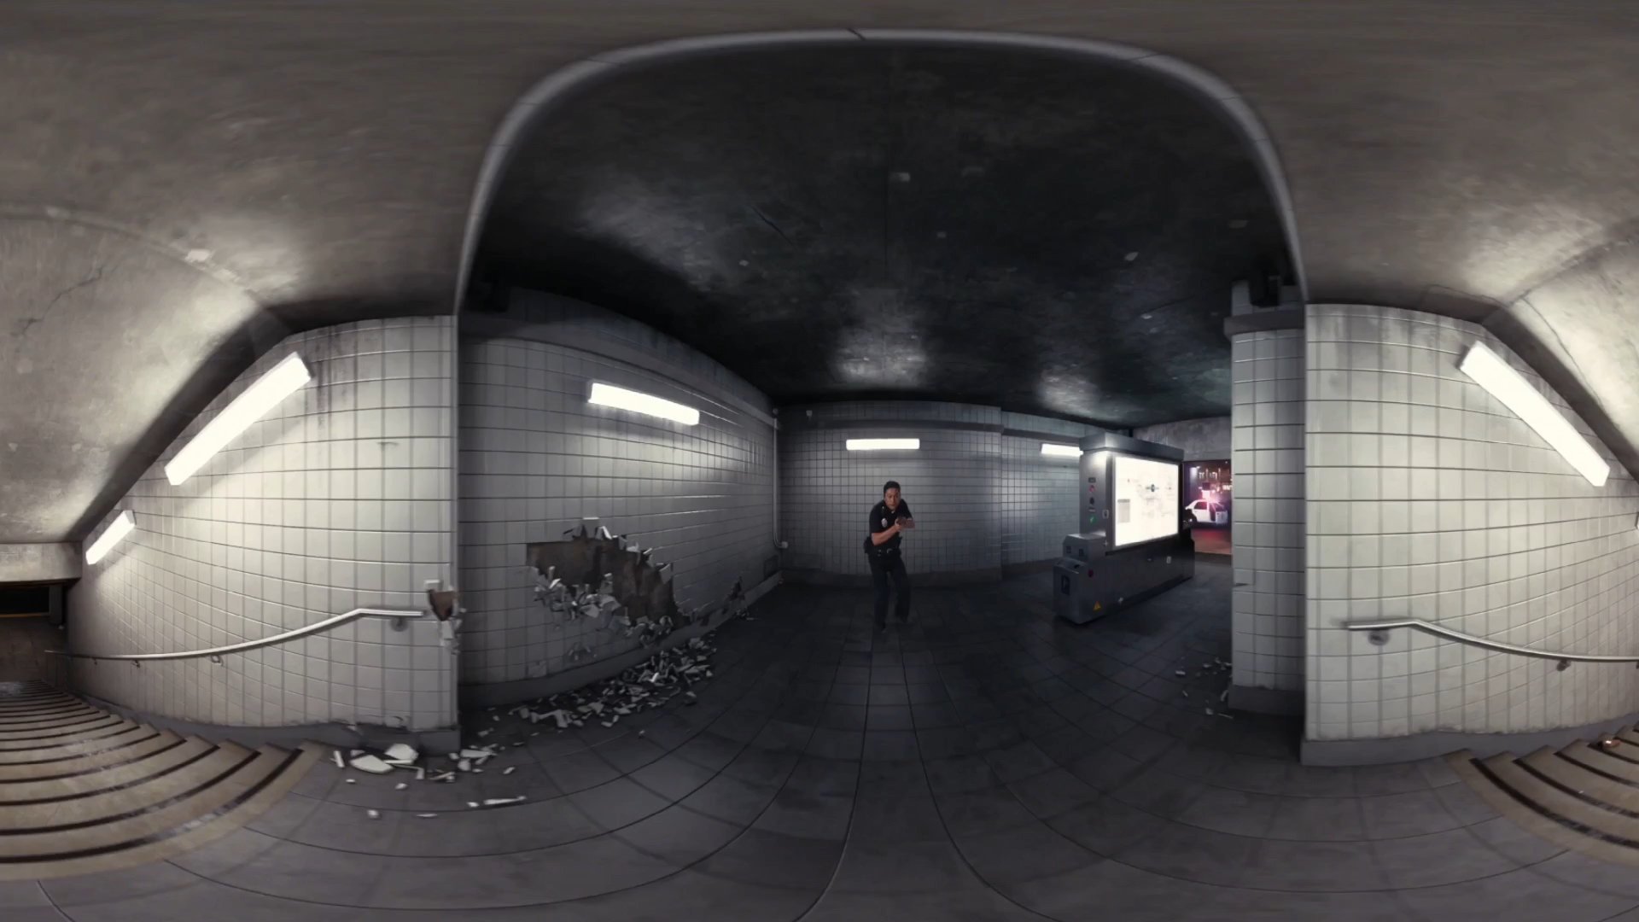

Slide 11
Item | W0 | W1 | W2 | W3 | W4 | W5 | W6 | - | W7 | W8 | W9 | W10
[Deadline] Research Proposal | 6-11
RQ 1: Finding data sets
RQ 1: Generating a framework
RQ 2: Research mathematical foundation of NGs
RQ 2: Develop Python NG generation tool
RQ 2: Test and validate the NG generation tool
RQ 3: Literature review on Markov Chains
[Deadline] Draft Paper |  |  |  |  |  | 11-12
RQ 3: Develop Python visualization tool for NGs
RQ 3: Characterize NGs
MQ: Combine RQs
MQ: Conclude MQ
Proofread
[Deadline] Final Paper |  |  |  |  |  |  |  |  |  |  | 22-01
[Deadline] Presentation |  |  |  |  |  |  |  |  |  |  |  | 29-01

Slide 12
SU (single user) prediction uses a simplified NG without the index
The simplified Navigation Graph for clients is defined as Gc = (S, Ec) where the set S consists of sets of visible tiles s and Ec is the matrix of probabilities of all edges
We will use a segment length (D) of 2 to 4 seconds
(https://bitmovin.com/mpeg-dash-hls-segment-length/)

Slide 13
Video + paper Suzan mentioned (360_icccn20.pdf (ucr.edu))
Time differencing when making NGs?
Horizontal movement is way more common than vertical (which confirms our observations)
Ridge regression is the best according to them, but in NG paper, it specifically mentions better performance than regression techniques (really promising!)
Less movement means better prediction, can we prove that a simpler NG leads to better predictions as well?
User-based customization (adding viewing behaviour to the prediction) helped more than video-based customization (using saliency/heatmaps).
This confirms the results mentioned in NG paper: Combining SU (single user) and CU (cross-user) is the most accurate

Slide 14
indegree/outdegree (source) (edges in and out)
Magnetic Laplacian of directed graphs through KPM (source) (source)
Spectral density
Chebyshev expansion
Stochastic trace estimator
Kernel smoothing
Entropy
Estrada index
Visual analysis (source) (source)
Using Markov chain on graphs (source) (source)

Slide 15
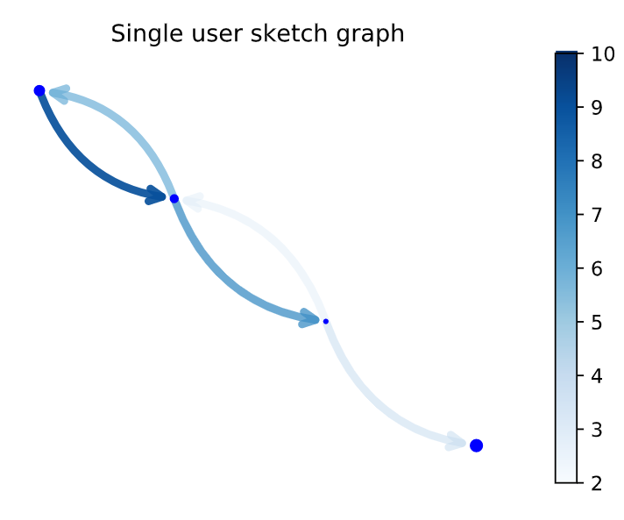

Slide 16
Item | W0 | W1 | W2 | W3 | W4 | W5 | W6 | - | W7 | W8 | W9 | W10
[Deadline] Research Proposal | 6-11
RQ 1: Finding data sets
RQ 1: Generating a framework
RQ 2: Research mathematical foundation of NGs
RQ 2: Develop Python NG generation tool
RQ 2: Test and validate the NG generation tool
RQ 3: Literature review on Markov Chains
[Deadline] Draft Paper |  |  |  |  |  | 11-12
RQ 3: Develop Python visualization tool for NGs
RQ 3: Characterize NGs
MQ: Combine RQs
MQ: Conclude MQ
Proofread
[Deadline] Final Paper |  |  |  |  |  |  |  |  |  |  | 22-01
[Deadline] Presentation |  |  |  |  |  |  |  |  |  |  |  | 29-01

Slide 17
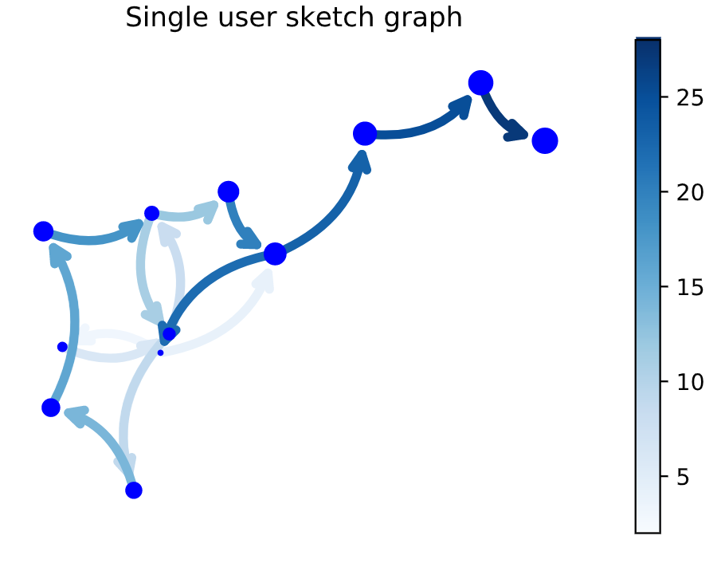

Slide 18
Item | W0 | W1 | W2 | W3 | W4 | W5 | W6 | - | W7 | W8 | W9 | W10
[Deadline] Research Proposal | 6-11
RQ 1: Finding data sets
RQ 1: Generating a framework
RQ 2: Research mathematical foundation of NGs
RQ 2: Develop Python NG generation tool
RQ 2: Test and validate the NG generation tool
RQ 3: Literature review on Markov Chains
[Deadline] Draft Paper |  |  |  |  |  | 11-12
RQ 3: Develop Python visualization tool for NGs
RQ 3: Characterize NGs
MQ: Combine RQs
MQ: Conclude MQ
Proofread
[Deadline] Final Paper |  |  |  |  |  |  |  |  |  |  | 22-01
[Deadline] Presentation |  |  |  |  |  |  |  |  |  |  |  | 29-01

Slide 19
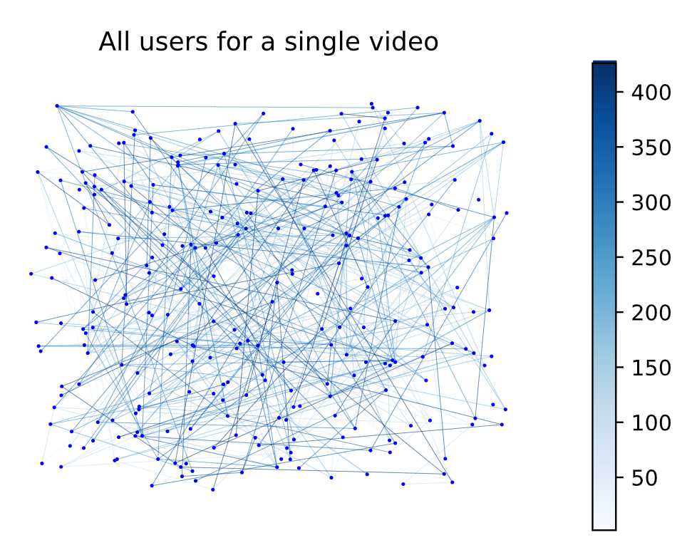

Slide 20
 | Characterization | Description | Metric(s)
1 | Dynamicity of subjects | By scoring how often a subject moves their head, the dynamicity of the subject can be determined and compared across various videos. Goal: find whether a subject has predictable watching behaviour. | Entropy, in/outdegree
2 | Dynamicity of videos | By scoring how often subjects move their head in a video, the dynamicity of the video can be determined and compared. Goal: find whether content causes dynamic watching behaviour. | Similarity, Clustering, Entropy, in/outdegree
3 | Does dynamicity stem from video or from subject | How do the results of 1 and 2 compare. Goal: find whether there is a connection between content, viewing behaviour, and subjects. | Comparison of 1 and 2
4 | Overlap between CU and SU | How well does the CU NG compare to the SU NGs, how useful is the distinction between CU and SU. Goal: find whether CU and SU are both necessary for prediction. | Similarity and Clustering analysis

Slide 21
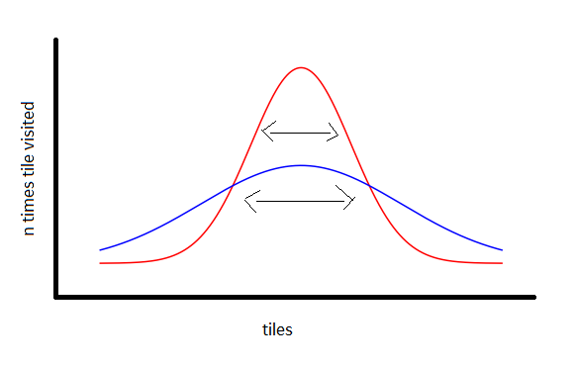
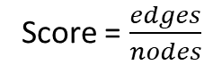
Dynamicity score idea
Dynamicity score now
Score = $\frac{edges}{nodes}$
Edges – how many transitions between nodes
Nodes – how many unique viewports has subject seen

Slide 22
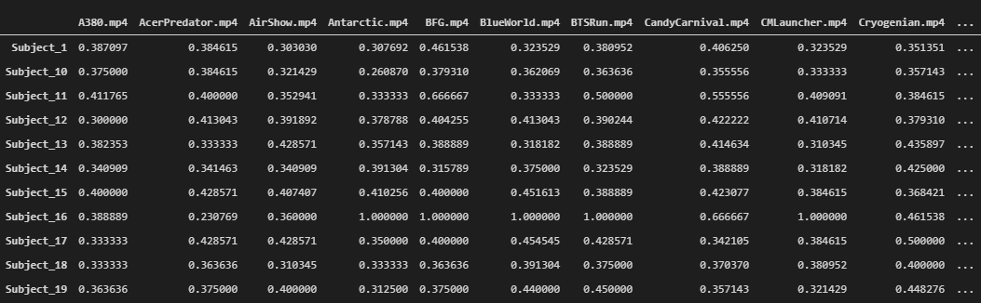
Score > 0.5, subject has barely moved his head (only between 2 or 3 tiles)
Score = 1, static view
Score < 0.4 dynamic viewing behaviour

Slide 23
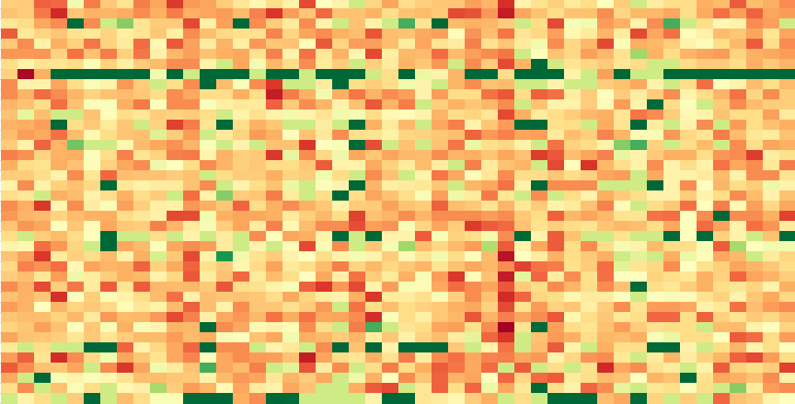
Viewing behaviour
Static
Videos
Subjects
Dynamic

Slide 24
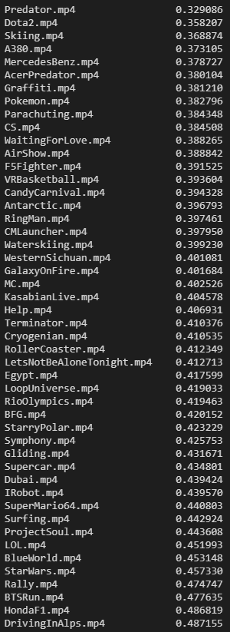
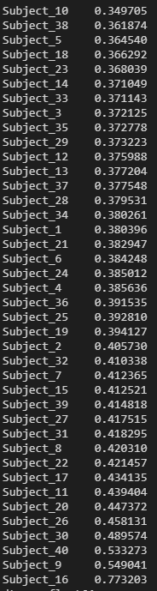

Slide 25
Item | W0 | W1 | W2 | W3 | W4 | W5 | W6 | - | W7 | W8 | W9 | W10
[Deadline] Research Proposal | 6-11
RQ 1: Finding data sets
RQ 1: Generating a framework
RQ 2: Research mathematical foundation of NGs
RQ 2: Develop Python NG generation tool
RQ 2: Test and validate the NG generation tool
RQ 3: Literature review on Markov Chains
[Deadline] Draft Paper |  |  |  |  |  | 11-12
RQ 3: Develop Python visualization tool for NGs
RQ 3: Characterize NGs
MQ: Combine RQs
MQ: Conclude MQ
Proofread
[Deadline] Final Paper |  |  |  |  |  |  |  |  |  |  | 22-01
[Deadline] Presentation |  |  |  |  |  |  |  |  |  |  |  | 29-01

Slide 26
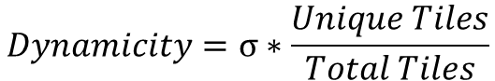
Number of visits to the tile
σ
Index of the tile
$$Dynamicity=σ∗\frac{Unique Tiles}{Total Tiles}$$

Slide 27
Score comparison
(file too large for GitHub)

Slide 28
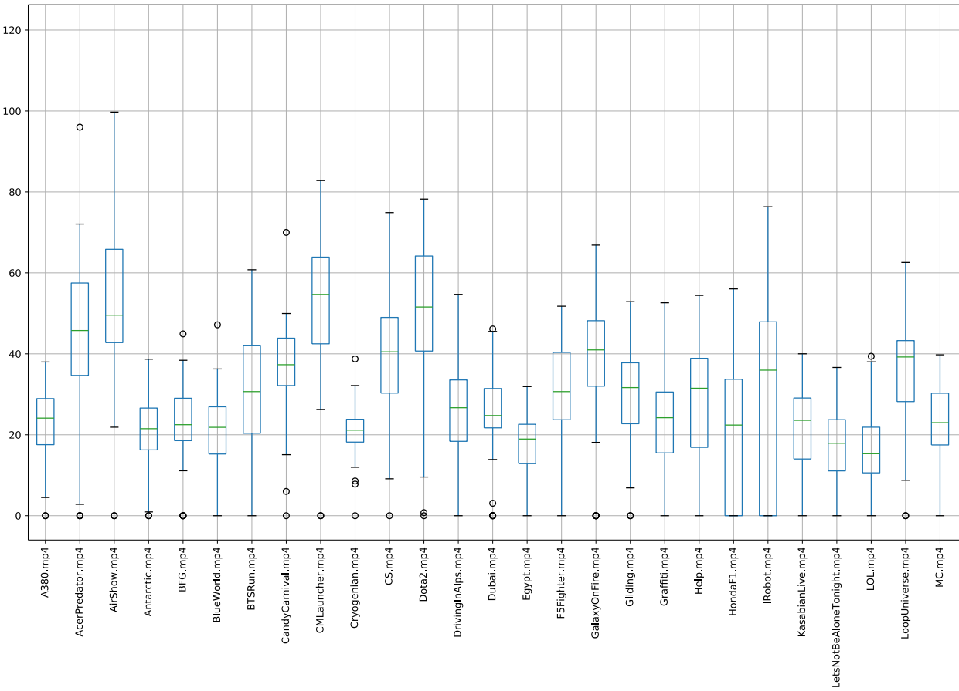

Slide 29
Item | W0 | W1 | W2 | W3 | W4 | W5 | W6 | - | W7 | W8 | W9 | W10
[Deadline] Research Proposal | 6-11
RQ 1: Finding data sets
RQ 1: Generating a framework
RQ 2: Research mathematical foundation of NGs
RQ 2: Develop Python NG generation tool
RQ 2: Test and validate the NG generation tool
RQ 3: Literature review on Markov Chains
[Deadline] Draft Paper |  |  |  |  |  | 11-12
RQ 3: Develop Python visualization tool for NGs
RQ 3: Characterize NGs
MQ: Combine RQs
MQ: Conclude MQ
Proofread
[Deadline] Final Paper |  |  |  |  |  |  |  |  |  |  | 22-01
[Deadline] Presentation |  |  |  |  |  |  |  |  |  |  |  | 29-01

Slide 30
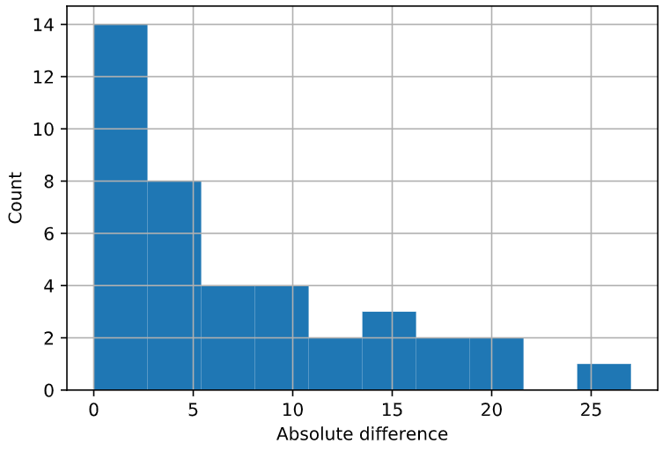
Dynamicity v1 and dynamicity v2 score comparison
(comparison of ranks on ordered list)

Slide 31
Item | W0 | W1 | W2 | W3 | W4 | W5 | W6 | - | W7 | W8 | W9 | W10
[Deadline] Research Proposal | 6-11
RQ 1: Finding data sets
RQ 1: Generating a framework
RQ 2: Research mathematical foundation of NGs
RQ 2: Develop Python NG generation tool
RQ 2: Test and validate the NG generation tool
RQ 3: Literature review on Markov Chains
[Deadline] Draft Paper |  |  |  |  |  | 11-12
RQ 3: Develop Python visualization tool for NGs
RQ 3: Characterize NGs
MQ: Combine RQs
MQ: Conclude MQ
Proofread
[Deadline] Final Paper |  |  |  |  |  |  |  |  |  |  | 22-01
[Deadline] Presentation |  |  |  |  |  |  |  |  |  |  |  | 29-01

Slide 32
Item | W0 | W1 | W2 | W3 | W4 | W5 | W6 | - | W7 | W8 | W9 | W10
[Deadline] Research Proposal | 6-11
RQ 1: Finding data sets
RQ 1: Generating a framework
RQ 2: Research mathematical foundation of NGs
RQ 2: Develop Python NG generation tool
RQ 2: Test and validate the NG generation tool
RQ 3: Literature review on Markov Chains
[Deadline] Draft Paper |  |  |  |  |  | 11-12
RQ 3: Develop Python visualization tool for NGs
RQ 3: Characterize NGs
MQ: Combine RQs
MQ: Conclude MQ
Proofread
[Deadline] Final Paper |  |  |  |  |  |  |  |  |  |  | 22-01
[Deadline] Presentation |  |  |  |  |  |  |  |  |  |  |  | 29-01

